Slide 1
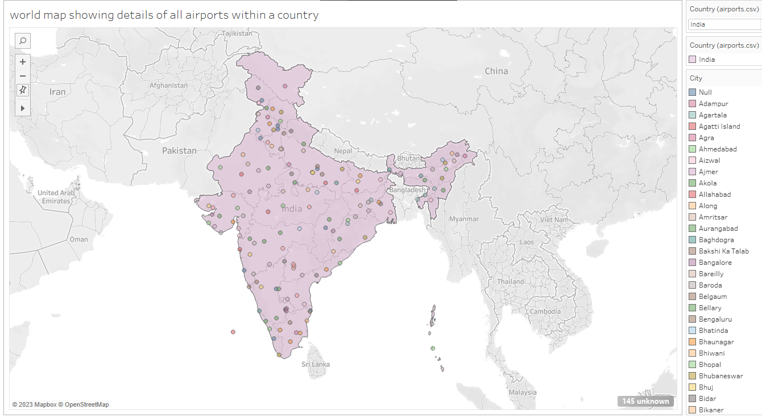
UNLOCKING INSIGHTS IN THE GLOBAL AIR TRANSPORTATION NETWORK
WORLD MAP SHOWING DETAILS OF ALL AIRPORTS WITHIN A COUNTRY

Slide 2
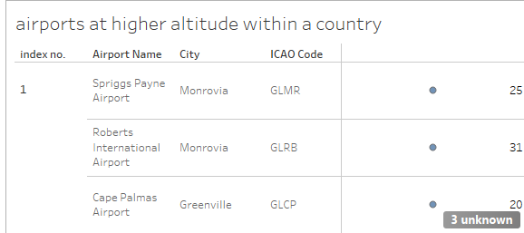
AIRPORTS AT HIGHER ALTITUDE WITHIN A COUNTRY

Slide 3
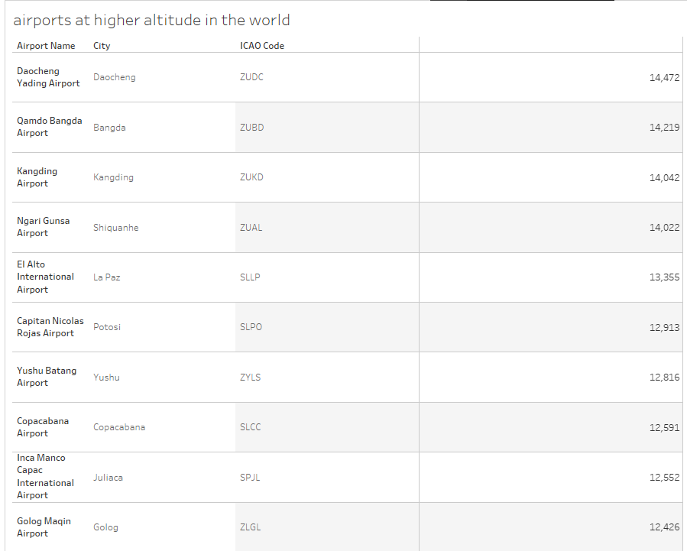
AIRPORTS AT HIGHER ALTITUDE IN THE WORLD

Slide 4
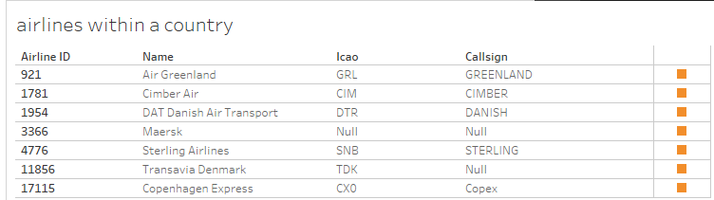
AIRLINES WITHIN A COUNTRY

Slide 5
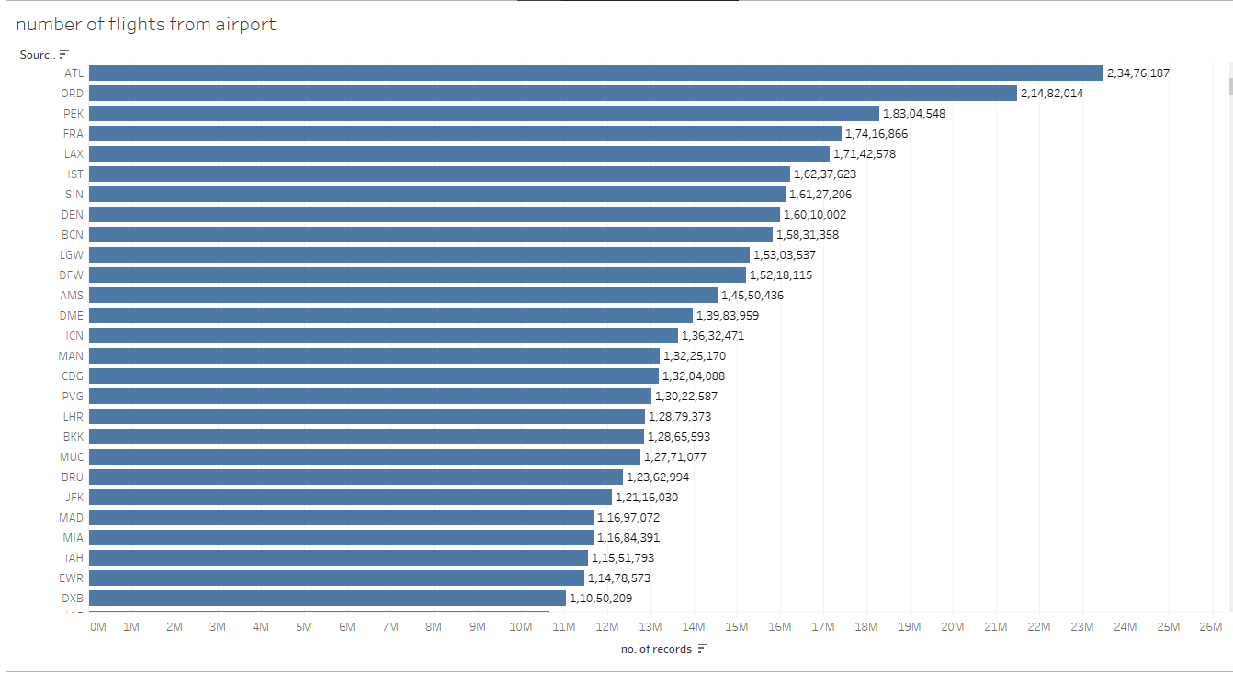
NUMBER OF FLIGHTS FROM AIRPORT

Slide 6
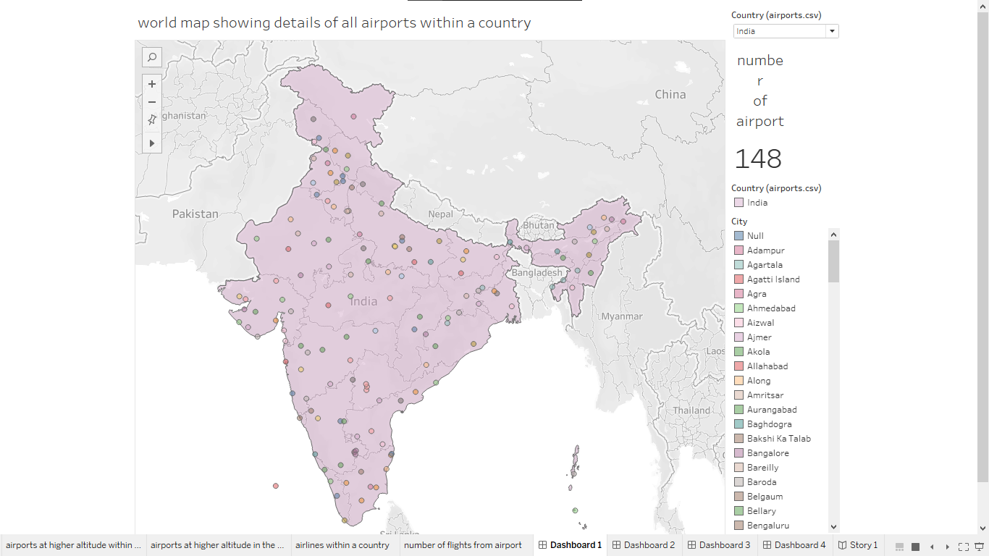
DASHBOARD 1

Slide 7
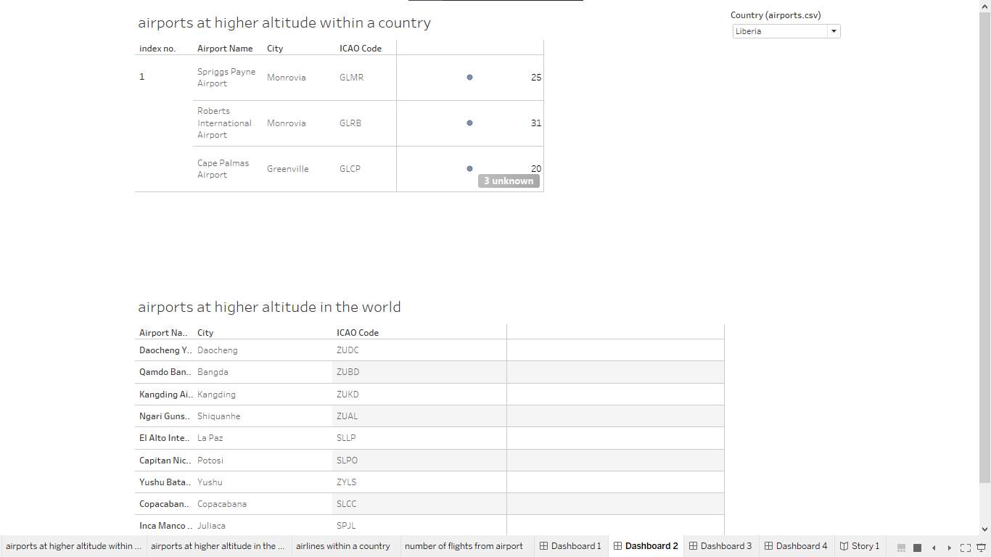
DASHBOARD 2

Slide 8
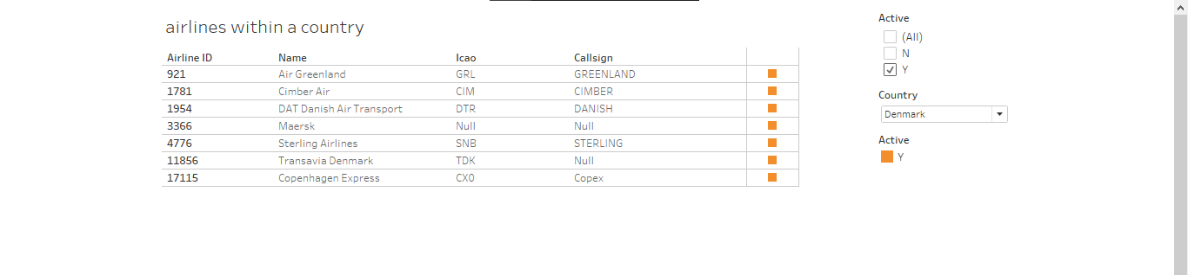
DASHBOARD 3

Slide 9
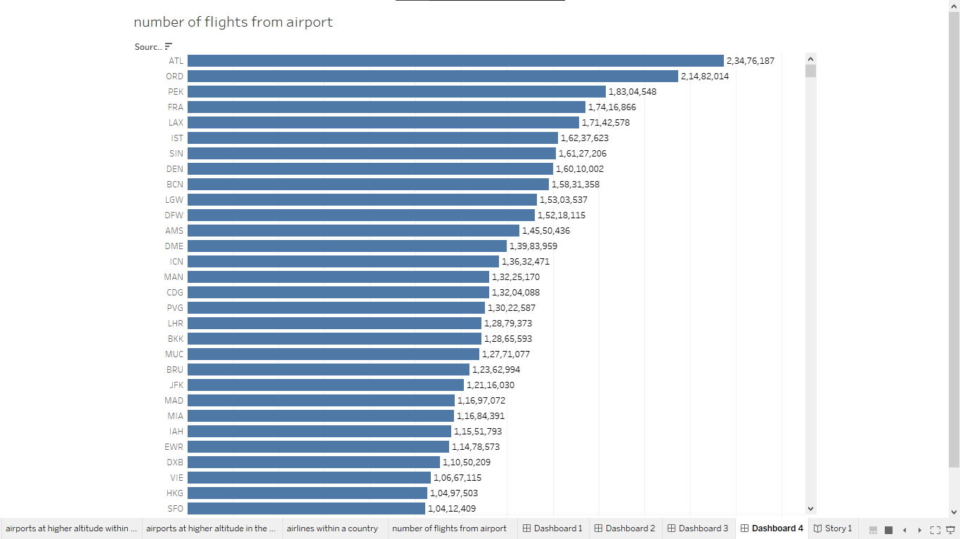
DASHBOARD 4

Slide 10
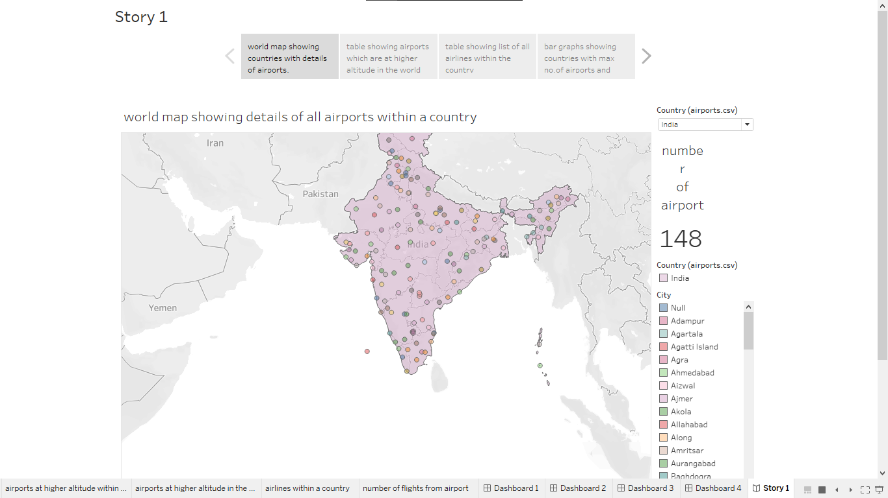
STORY

